Slide 1
Network Fundamentals for Cloud
Nishit Narang
WILPD-CSIS

Slide 2
CC ZG503: Network Fundamentals for Cloud
Lecture No. 6: Transport Layer Fundamentals + SDN

Slide 3
Fundamentals of Networking:
Transport Layer Concepts
Slides Source: Computer Networking: A Top-Down Approach, 8th edition, Jim Kurose, Keith Ross, Pearson, 2020
All material copyright 1996-2020
J.F Kurose and K.W. Ross, All Rights Reserved

Slide 4


















Transport services and protocols
application
transport
network
data link
physical
provide logical communication between application processes running on different hosts
mobile network
national or global ISP
transport protocols actions in end systems:
sender: breaks application messages into segments, passes to network layer
receiver: reassembles segments into messages, passes to application layer
logical end-end transport
local or regional ISP
home network
content
provider
network
application
transport
network
data link
physical
datacenter
network
two transport protocols available to Internet applications
TCP, UDP
enterprise
network
Notes:
By logical communication , we
mean that from an application’s perspective, it is as if the hosts running the processes
were directly connected; in reality, the hosts may be on opposite sides of the
planet, connected via numerous routers and a wide range of link types. Application
processes use the logical communication provided by the transport layer to send
messages to each other, free from the worry of the details of the physical infrastructure
used to carry these messages.
Let’s look at each of these three (logical communications, actions,

Slide 5
Two principal Internet transport protocols
application
transport
network
data link
physical
TCP: Transmission Control Protocol
reliable, in-order delivery
congestion control
flow control
connection setup
UDP: User Datagram Protocol
unreliable, unordered delivery
no-frills extension of “best-effort” IP
services not available:
delay guarantees
bandwidth guarantees
mobile network
national or global ISP
logical end-end transport
local or regional ISP
home network
content
provider
network
application
transport
network
data link
physical
datacenter
network
enterprise
network

Slide 6
UDP: User Datagram Protocol
Why is there a UDP?
“no frills,” “bare bones” Internet transport protocol
“best effort” service, UDP segments may be:
lost
delivered out-of-order to app
no connection establishment (which can add RTT delay)
simple: no connection state at sender, receiver
small header size
no congestion control
UDP can blast away as fast as desired!
can function in the face of congestion
connectionless:
no handshaking between UDP sender, receiver
each UDP segment handled independently of others

Slide 7
UDP: User Datagram Protocol
UDP use:
streaming multimedia apps (loss tolerant, rate sensitive)
DNS
SNMP
HTTP/3
if reliable transfer needed over UDP (e.g., HTTP/3):
add needed reliability at application layer
add congestion control at application layer

Slide 8
UDP: Transport Layer Actions
SNMP client
SNMP server
application
application
transport
(UDP)
transport
(UDP)
network (IP)
network (IP)
link
link
physical
physical

Slide 9
UDP: Transport Layer Actions
SNMP client
SNMP server
UDP sender actions:
application
application
is passed an application-layer message
SNMP msg
transport
(UDP)
transport
(UDP)
determines UDP segment header fields values
UDP_{h}
SNMP msg
UDP_{h}
creates UDP segment
network (IP)
network (IP)
passes segment to IP
link
link
physical
physical

Slide 10
UDP: Transport Layer Actions
SNMP client
SNMP server
UDP receiver actions:
application
receives segment from IP
application
checks UDP checksum header value
transport
(UDP)
transport
(UDP)
SNMP msg
extracts application-layer message
network (IP)
network (IP)
SNMP msg
UDP_{h}
demultiplexes message up to application via socket
link
link
physical
physical

Slide 11
TCP: overview RFCs: 793,1122, 2018, 5681, 7323
point-to-point:
one sender, one receiver
reliable, in-order byte steam:
no “message boundaries"
full duplex data:
bi-directional data flow in same connection
MSS: maximum segment size
cumulative ACKs
pipelining:
TCP congestion and flow control set window size
connection-oriented:
handshaking (exchange of control messages) initializes sender, receiver state before data exchange
flow controlled:
sender will not overwhelm receiver
Notes:
Typical MSS is 1460 bytes

Slide 12
TCP segment structure
32 bits
source port #
dest port #
segment seq #: counting bytes of data into bytestream (not segments!)
ACK: seq # of next expected byte; A bit: this is an ACK
sequence number
acknowledgement number
length (of TCP header)
head
len
not
used
A
P
S
receive window
flow control: # bytes receiver willing to accept
C
E
U
R
F
Internet checksum
checksum
Urg data pointer
options (variable length)
C, E: congestion notification
TCP options
application
data
(variable length)
data sent by application into TCP socket
RST, SYN, FIN: connection management

Slide 13
TCP sequence numbers, ACKs
outgoing segment from sender
Sequence numbers:
byte stream “number” of first byte in segment’s data
source port #
dest port #
sequence number
acknowledgement number
rwnd
checksum
urg pointer
window size
N
Acknowledgements:
seq # of next byte expected from other side
cumulative ACK
sender sequence number space
sent
ACKed
sent, not-yet ACKed
(“in-flight”)
usable
but not
yet sent
not
usable
Q: how receiver handles out-of-order segments
A: TCP spec doesn’t say, - up to implementor
outgoing segment from receiver
source port #
dest port #
sequence number
acknowledgement number
A
rwnd
checksum
urg pointer

Slide 14

TCP sequence numbers, ACKs
Host A
Host B
User types‘C’
Seq=42, ACK=79, data = ‘C’
host ACKs receipt of‘C’, echoes back ‘C’
Seq=79, ACK=43, data = ‘C’
host ACKs receipt of echoed ‘C’
Seq=43, ACK=80
simple telnet scenario
Notes:
The key thing to note here is that the ACK number (43) on the B-to-A segment is one more than the sequence number (42) on the A-toB segment that triggered that ACK
Similarly, the ACK number (80) on the last A-to-B segment is one more than the sequence number (79) on the B-to-A segment that triggered that ACK

Slide 15
TCP round trip time, timeout
Q: how to set TCP timeout value?
longer than RTT, but RTT varies!
too short: premature timeout, unnecessary retransmissions
too long: slow reaction to segment loss
Q: how to estimate RTT?
SampleRTT:measured time from segment transmission until ACK receipt
ignore retransmissions
SampleRTT will vary, want estimated RTT “smoother”
average several recent measurements, not just current SampleRTT

Slide 16
TCP round trip time, timeout
EstimatedRTT = (1- α)*EstimatedRTT + α*SampleRTT
exponential weighted moving average (EWMA)
influence of past sample decreases exponentially fast
typical value: α = 0.125
RTT: gaia.cs.umass.edu to fantasia.eurecom.fr
RTT (milliseconds)
sampleRTT
EstimatedRTT
time (seconds)
Notes:
This is how TCP re-computes the estimated RTT each time a new SampleRTT is taken.
The process is knows as an exponeitally weighted moving average, shown by the equation here.
<say it>
Where alpha reflects the influence of the most recent measurements on the estimated RTT; a typical value of alpha used in implementaitons is .125
The graph at the bottom show measured RTTs beween a host in the Massachusetts and a host in France, as well as the estimated, “smoothed” RTT

Slide 17
TCP: retransmission scenarios
Host A
Host B
Host A
Host B
SendBase=92
Seq=92, 8 bytes of data
Seq=92, 8 bytes of data
timeout
timeout
Seq=100, 20 bytes of data
ACK=100
X
ACK=100
ACK=120
Seq=92, 8 bytes of data
Seq=92, 8
bytes of data
SendBase=100
send cumulative
ACK for 120
SendBase=120
ACK=100
ACK=120
SendBase=120
lost ACK scenario
premature timeout
Notes:
To cement our understanding of TCP reliability, let’s look a a few retransmission scenarios
In the first case a TCP segments is transmited and the ACK is lost, and the TCP timeout mechanism results in another copy of being transmitted and then re-ACKed a the sender
In the second example two segments are sent and acknowledged, but there is a premature timeout e for the first segment, which is retransmitted. Notet that when this retransmitted segment is received, the receiver has already received the first two segments, and so resends a cumulative ACK for both segments received so far, rather than an ACK for just this fist segment.

Slide 18
TCP: retransmission scenarios
Host A
Host B
Seq=92, 8 bytes of data
Seq=100, 20 bytes of data
ACK=100
X
ACK=120
Seq=120, 15 bytes of data
cumulative ACK covers for earlier lost ACK
Notes:
And in this last example, two segments are again transmitted, the first ACK is lost but the second ACK, a cumulative ACK arrives at the sender, which then can transmit a third segment, knowing that the first two have arrived, even though the ACK for the first segment was lost

Slide 19
TCP flow control
application
process
Q: What happens if network layer delivers data faster than application layer removes data from socket buffers?
Application removing data from TCP socket buffers
TCP socket
receiver buffers
TCP
code
Network layer delivering IP datagram payload into TCP socket buffers
IP
code
from sender
receiver protocol stack
Notes:
(Presuming an intro)
Before diving into the details of TCP flow control, let’s first get the general context and motivate the need for flow control.
This diagram show a typical transport-layer implementation
A segment is brought up the protocol stack to the transport layer, and the segment’s payload is removed from the segment and written INTO socket buffers.
How does data get taken OUT of socket buffers? By applications performing socket reads, as we learned in Chapter 2.
And so the question is “What happens if network layer delivers data faster than an application-layer process removes data from socket buffers?”
Let’s watch a video of what happens when things arrive way too fast to fast to be processed.
<video>. (I love that video). Another human analogy showing the need for flow control is the saying – to use some English slang - “no one can drink from a firehose”
Flow control is a mechanism to the calamity of a receiver being over-run by a sender that is sending too fast – it allows the RECEIVER to explictly control the SENDER so sender won’t overflow receiver’s buffer by transmitting too much, too fast

Slide 20

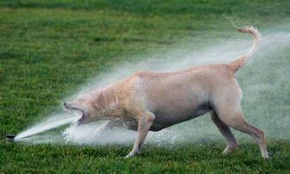
TCP flow control
application
process
Q: What happens if network layer delivers data faster than application layer removes data from socket buffers?
Application removing data from TCP socket buffers
TCP socket
receiver buffers
TCP
code
Network layer delivering IP datagram payload into TCP socket buffers
IP
code
from sender
receiver protocol stack
Notes:
(Presuming an intro)
Before diving into the details of TCP flow control, let’s first get the general context and motivate the need for flow control.
This diagram show a typical transport-layer implementation
A segment is brought up the protocol stack to the transport layer, and the segment’s payload is removed from the segment and written INTO socket buffers.
How does data get taken OUT of socket buffers? By applications performing socket reads, as we learned in Chapter 2.
And so the question is “What happens if network layer delivers data faster than an application-layer process removes data from socket buffers?”
Let’s watch a video of what happens when things arrive way too fast to fast to be processed.
<video>. (I love that video). Another human analogy showing the need for flow control is the saying – to use some English slang - “no one can drink from a firehose”
Flow control is a mechanism to the calamity of a receiver being over-run by a sender that is sending too fast – it allows the RECEIVER to explictly control the SENDER so sender won’t overflow receiver’s buffer by transmitting too much, too fast

Slide 21
TCP flow control
application
process
Q: What happens if network layer delivers data faster than application layer removes data from socket buffers?
Application removing data from TCP socket buffers
TCP socket
receiver buffers
TCP
code
receive window
flow control: # bytes receiver willing to accept
IP
code
from sender
receiver protocol stack
Notes:
(Presuming an intro)
Before diving into the details of TCP flow control, let’s first get the general context and motivate the need for flow control.
This diagram show a typical transport-layer implementation
A segment is brought up the protocol stack to the transport layer, and the segment’s payload is removed from the segment and written INTO socket buffers.
How does data get taken OUT of socket buffers? By applications performing socket reads, as we learned in Chapter 2.
And so the question is “What happens if network layer delivers data faster than an application-layer process removes data from socket buffers?”
Let’s watch a video of what happens when things arrive way too fast to fast to be processed.
<video>. (I love that video). Another human analogy showing the need for flow control is the saying – to use some English slang - “no one can drink from a firehose”
Flow control is a mechanism to the calamity of a receiver being over-run by a sender that is sending too fast – it allows the RECEIVER to explictly control the SENDER so sender won’t overflow receiver’s buffer by transmitting too much, too fast

Slide 22
TCP flow control
application
process
Q: What happens if network layer delivers data faster than application layer removes data from socket buffers?
Application removing data from TCP socket buffers
TCP socket
receiver buffers
TCP
code
flow control
receiver controls sender, so sender won’t overflow receiver’s buffer by transmitting too much, too fast
IP
code
from sender
receiver protocol stack
Notes:
(Presuming an intro)
Before diving into the details of TCP flow control, let’s first get the general context and motivate the need for flow control.
This diagram show a typical transport-layer implementation
A segment is brought up the protocol stack to the transport layer, and the segment’s payload is removed from the segment and written INTO socket buffers.
How does data get taken OUT of socket buffers? By applications performing socket reads, as we learned in Chapter 2.
And so the question is “What happens if network layer delivers data faster than an application-layer process removes data from socket buffers?”
Let’s watch a video of what happens when things arrive way too fast to fast to be processed.
<video>. (I love that video). Another human analogy showing the need for flow control is the saying – to use some English slang - “no one can drink from a firehose”
Flow control is a mechanism to the calamity of a receiver being over-run by a sender that is sending too fast – it allows the RECEIVER to explictly control the SENDER so sender won’t overflow receiver’s buffer by transmitting too much, too fast

Slide 23
TCP flow control
TCP receiver “advertises” free buffer space in rwnd field in TCP header
RcvBuffer size set via socket options (typical default is 4096 bytes)
many operating systems autoadjust RcvBuffer
sender limits amount of unACKed (“in-flight”) data to received rwnd
guarantees receive buffer will not overflow
to application process
RcvBuffer
buffered data
rwnd
free buffer space
TCP segment payloads
TCP receiver-side buffering
Notes:
Here’s how TCP implement flow control. The basic idea is simple – the receiver informs the sender how much free buffer space there is, and the sender is limited to send no more than this amount of data. That the value o RWND in the diagram to the right.
This information is carried from the receiver to the sender in the “receiver advertised window” (do a PIP of header) in the TCP header, and the value will change as the amount of free buffer space fluctuates over time.

Slide 24
TCP connection management
before exchanging data, sender/receiver “handshake”:
agree to establish connection (each knowing the other willing to establish connection)
agree on connection parameters (e.g., starting seq #s)
application
application
connection state: ESTAB
connection variables:
seq # client-to-server
server-to-client
rcvBuffer size
at server,client
connection state: ESTAB
connection Variables:
seq # client-to-server
server-to-client
rcvBuffer size
at server,client
network
network
Socket clientSocket =
newSocket("hostname","port number");
Socket connectionSocket = welcomeSocket.accept();
Notes:
The other TCP topic we’ll want to consider here is that of “connection management”
The TCP sender and reciver have a number of pieces of shared state that they must establish before actually communication
FIRST theym ust both agree that they WANT to communicate with each other
Secondly there are connection parameters – the initial sequence number and the initial receiver-advertised bufferspace that they’ll want to agree on
This is done via a so-called handshake protocol – the client reaching our to the server, and the server answering back.
And before diving into the TCP handshake protocol, let’s first consider the problem of handshaking, of establishing shared state.

Slide 25
TCP 3-way handshake
Server state
Client state
serverSocket = socket(AF_INET,SOCK_STREAM)
serverSocket.bind((‘’,serverPort))
serverSocket.listen(1)
connectionSocket, addr = serverSocket.accept()
clientSocket = socket(AF_INET, SOCK_STREAM)
LISTEN
clientSocket.connect((serverName,serverPort))
LISTEN
choose init seq num, x
send TCP SYN msg
SYNSENT
SYNbit=1, Seq=x
choose init seq num, y
send TCP SYNACK
msg, acking SYN
SYN RCVD
SYNbit=1, Seq=y
ACKbit=1; ACKnum=x+1
received SYNACK(x)
indicates server is live;
send ACK for SYNACK;
this segment may contain
client-to-server data
ESTAB
ACKbit=1, ACKnum=y+1
received ACK(y)
indicates client is live
ESTAB
Notes:
TCP’s three way handshake, that operates as follows
Let’s say the client and server both create a TCP socket as we learned about in Chapter 2 and enter the LISTEN state
The client then connects to the server sending a SYN message with a sequence number x (SYN Message is an TCP Segment with SYN but set in the header – you might want to go back and review the TCP segment format!)
The server is waiting for a connection, and receives the SYN message enters the SYN received state (NOT the established state and sends a SYN ACK message back.
Finally the client sends an ACK message to the server, and when the server receiver this enters the ESTABLished state. This is when the application process would see the return from the wait on the socket accept() call

Slide 26
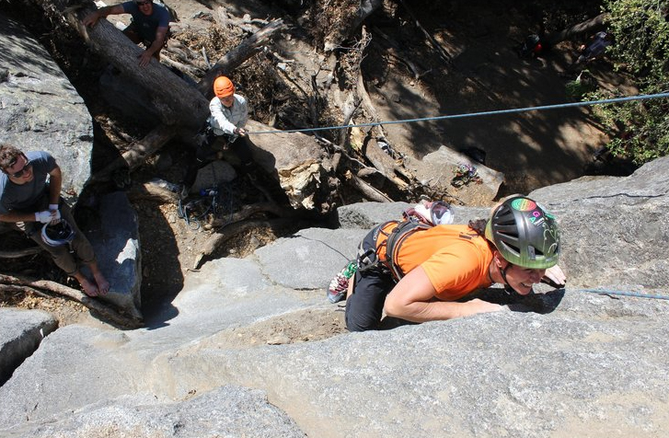
A human 3-way handshake protocol
1. On belay?
2. Belay on.
3. Climbing.
Notes:
As usual, there’s a human protocol analogy to the three way handshake, and I still remember thinking about this clinging for my life while climbing up a rockface
When you want start climbing you first say ON BELOW (meaning ARE YOU READY WITH MY SAFETY ROPE)
THE BELYER (server) responds BELAY ON (that lets you know the belayer is ready for you)
And then you say CLIMING
It’s amazing what can pass through your head when your clinging for your life o a

Slide 27
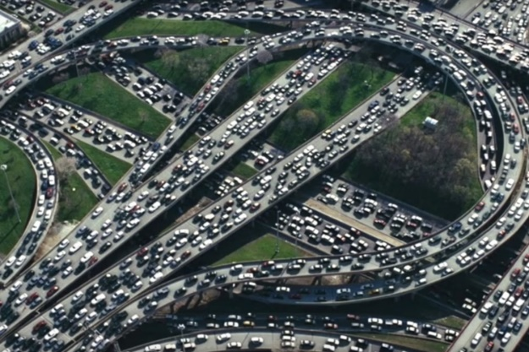
Principles of congestion control
Congestion:
informally: “too many sources sending too much data too fast for network to handle”
manifestations:
long delays (queueing in router buffers)
packet loss (buffer overflow at routers)
different from flow control!
congestion control: too many senders, sending too fast
a top-10 problem!
flow control: one sender too fast for one receiver

Slide 28

Approaches towards congestion control
End-end congestion control:
no explicit feedback from network
congestion inferred from observed loss, delay
ACKs
data
data
ACKs
approach taken by TCP

Slide 29
Approaches towards congestion control
Network-assisted congestion control:
routers provide direct feedback to sending/receiving hosts with flows passing through congested router
may indicate congestion level or explicitly set sending rate
explicit congestion info
ACKs
data
data
ACKs
TCP ECN, ATM, DECbit protocols

Slide 30
TCP congestion control: AIMD
approach: senders can increase sending rate until packet loss (congestion) occurs, then decrease sending rate on loss event
Additive Increase
Multiplicative Decrease
increase sending rate by 1 maximum segment size every RTT until loss detected
cut sending rate in half at each loss event
AIMD sawtooth
behavior: probing
for bandwidth
TCP sender Sending rate
time

